Slide 1
Validity of traffic signs individual class project
Jeff walker
ECE
04/22/2021

Slide 2

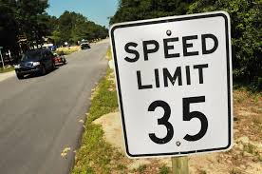
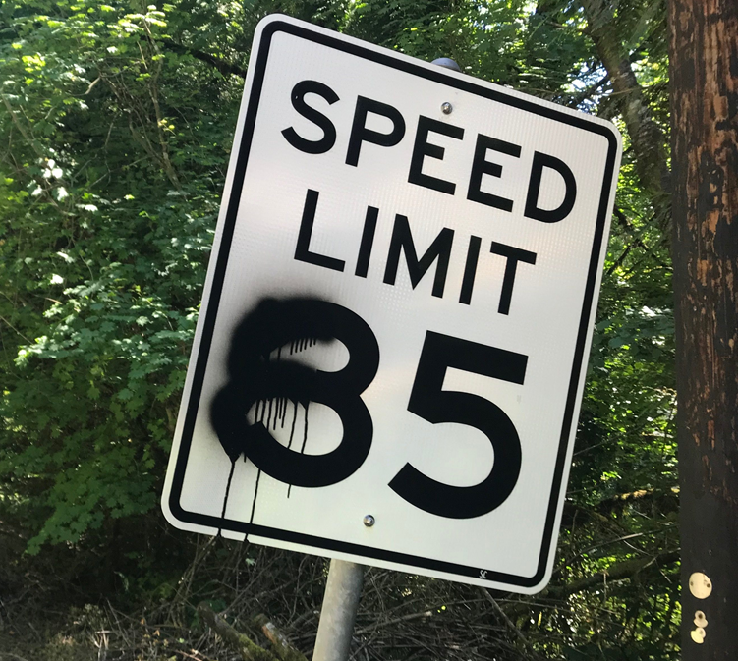
Validity of traffic signs
The goal is to train a CNN to accurately predict the validation of a road sign and a sign that have been tampered with

Slide 3
Approach
Train a CNN model to classify traffic signs including vandalized signs
The model will include classes of road signs +1 to add an additional class to the network for vandalized signs

Slide 4
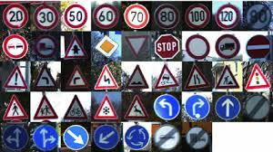
DataSet
Train a CNN architecture to classify traffic signs including vandalized signs
Kaggle supplies a GTSRB dataset of 50k images and photos of road signs of 40 classes
This was much too large so an altered dataset was derived from the GTSRB

Slide 5
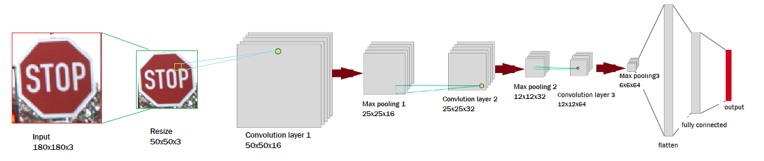
Architecture
The CNN consists of three convolution blocks with a max pool layer in each of them, with an additional flattening layer and 0.2 dropout regularization. The fully connected layer has 128 units on top of it that is activated by rectifier activation

Slide 6
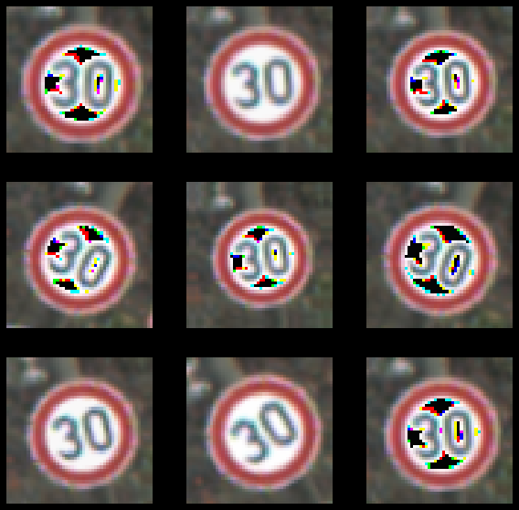
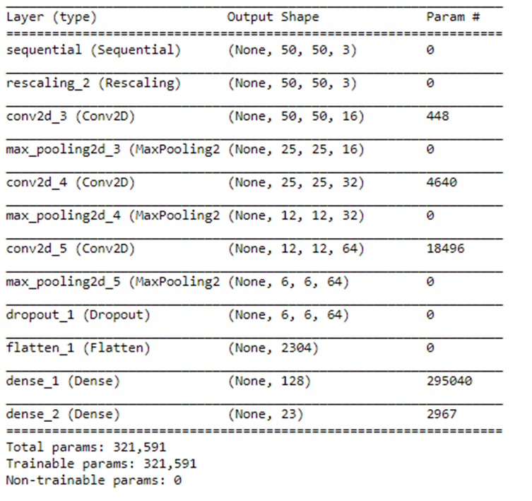
Model
Augmentation was used to improve the accuracy in training the model and to prevent overfitting while the dropout layer help reduce the network capacity
This approach was necessary to achieve a more optimally trained model

Slide 7
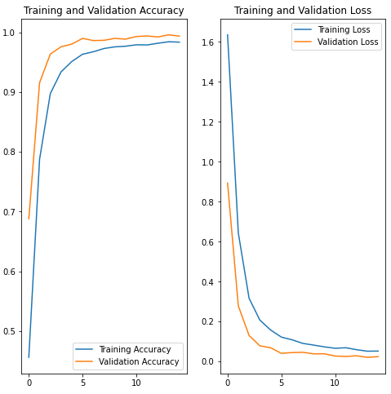
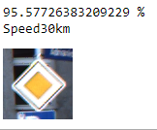
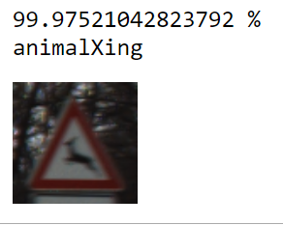
Findings
The results of the trained model was less than perfect. There were many confident false positives
The cost was extremely high and there was no room for errors to be added into as an “unknown class”

Slide 8
References:
Sermanet, P., & LeCun, Y. (2019). New York University; Courant Institute of Mathematical Sciences.
D. Keysers, T. Deselaers, C. Gollan and H. Ney, "Deformation Models for Image Recognition," in IEEE Transactions on Pattern Analysis and Machine Intelligence, vol. 29, no. 8, pp. 1422-1435, Aug. 2007, doi: 10.1109/TPAMI.2007.1153.
https://www.tensorflow.org/

